Slide 1
Ethnography
Doing Political Research

Slide 2
Ethnography and Participant Observation?
Ethnography
Extended immersion of the researcher in the life of a particular ‘social world,’ for example, a far-right political group, a police unit, the House of Lords
Can involve observation of group and individual behaviour, participation in group activities, interviews with groups and individuals and analyses of material culture, written documents etc
Aim to reach deep understanding of the group’s culture
Participant observation: a core method of ethnography involving the observation of a ‘social world’ as a participant
Focus on the politics of the everyday and lived experiences

Slide 3
Types of Observation
Complete participant
The researcher is native in the social world
Reflexive insider accounts - experiences become data in retrospect
Diaries, notes, professional output etc become sources
Participant observer
The researcher enters the social world to study it and participates to a greater or lesser extent
Complete observer
The study of naturally occurring data, where the researcher is not present
Taking part in participants’ daily lives, collecting observational data
For example, audio/video recordings, photographs, documents, websites

Slide 4
Etic vs Emic
Etic: the perspective of the analyst who learns the rules and norms of the social group, reflects on this learning process and identifies the significance of the rules learned
Emic: the perspective of the insider, the native, who sees things ‘though the eyes’ of participants, allowing access to the logic and norms of the participants
Ethnographic research allows the researcher to adopt both roles, and the tension between them drives ethnographic analysis

Slide 5
Ethnography vs Interviews/Focus Groups
 | Ethnography | Interviews/Focus Groups
Type of interaction | Informal | More formal
Role of researcher | Participant/observer | Clearly defined role as researcher
Setting | The social world under investigation | Often distinct from the social world
Recording information | Field notes | Audio/visual recordings + notes

Slide 6

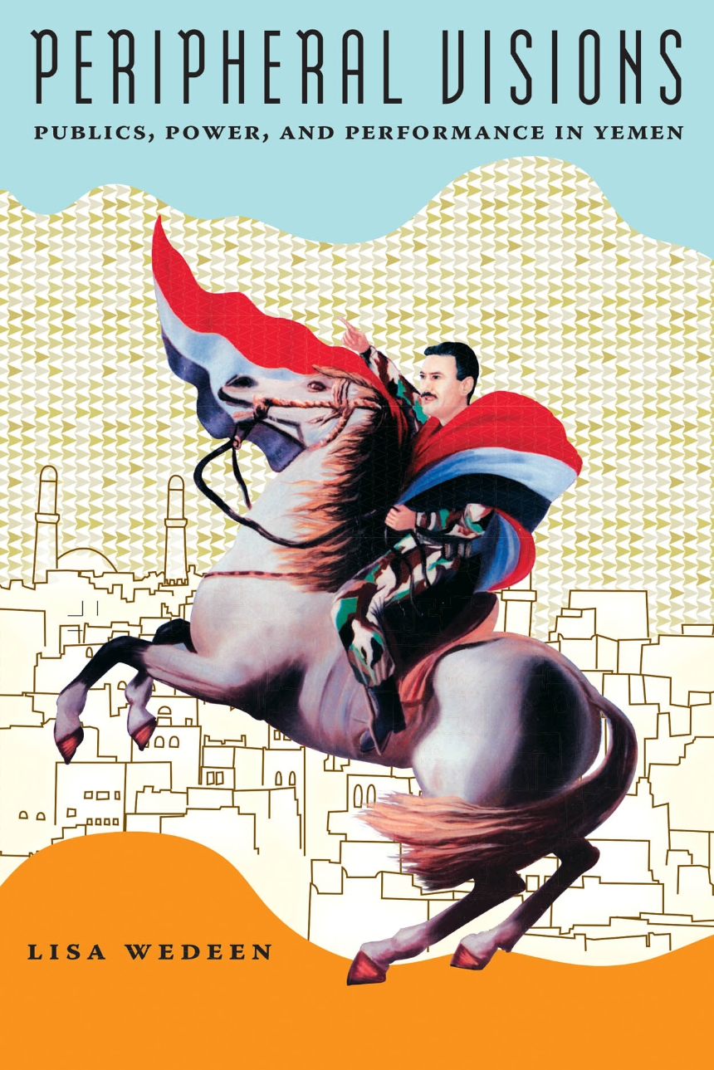

Ethnography in Political Research

Slide 7
Designing Ethnographic Research
Identifying research sites
Open vs closed settings
Representativeness?
Overt vs covert (ethical implications)
Extent of participation
Use of one or multiple sites and comparison
Often dependent on practical issues

Slide 8
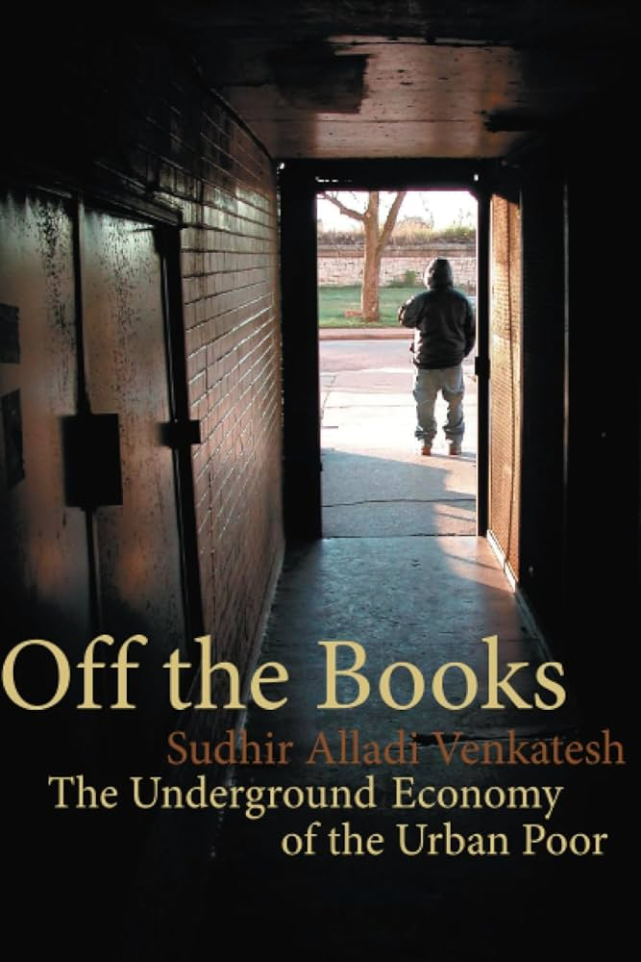
Access
Access shapes the study
Open settings are much easier to get access to
Often a pragmatic decision, based on existing networks of connections
Gatekeepers, key informants and earning trust are crucial

Slide 9
Overt or Covert?
Why covert?
Access to naturally occurring phenomena, not influenced by the presence of the researcher
Impossibility of gathering data in any other way
Participants may insist researcher participates in potential illegal or dangerous activities
But
Violation of informed consent
Danger of blowing cover
Difficult to take notes and combine with other methods

Slide 10
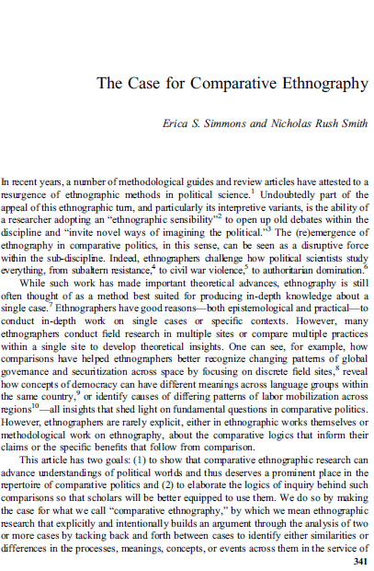
Comparison
Benefits:
generalisability
questioning of concepts
studying the effects of practices in different settings
refining of the political phenomena under study
But: comparison often requires more resources

Slide 11
Conclusion
Ethnography is the traditional method of anthropology but is increasingly used in other social sciences
Conducting ethnography is time-consuming and there are many practical challenges
It gets us closer than other methods to lived experiences and everyday understandings of political processes, but there is a trade-off with generalisability

